Slide 1

Chapter 7 selected topics
Circuit technology
ASIC and CAD
Circuit classification
Circuit design and fabrication
Design flow
Design Constraints
  Performance
  Power
Functional verification using OBDD
7 - <number>

Slide 2
Circuit technology
  First Generation: Vacuum Tube
  Second Generation: Transistor
    invented in 1947
    smaller, faster, cheaper
    IBM-709TX in 1958
  Third Generation: IC (Integrated Circuit)
    many tiny transistors on a single chip
    IBM-360 in 1964
  Fourth Generation: LSI (Large Scale Integrated), VLSI (Very ~)
    millions of transistors on a single chip
    DEC’s minicomputer, PDP-11 and IBM-370 mainframe in 1970, 1971
    Today’s personal computers
Small transistor technology makes faster and cheaper
7 - <number>

Slide 3
Integrated circuits
Integrated circuit (informally, a “chip”) is a semiconductor crystal (most often silicon) containing the electronic components for the digital gates and storage elements which are interconnected on the chip.
Terminology - Levels of chip integration
  SSI (small-scale integrated) - fewer than 10 gates
  MSI (medium-scale integrated) - 10 to 100 gates
  LSI (large-scale integrated) - 100 to thousands of gates
  VLSI (very large-scale integrated) - thousands to 100s of millions of gates
7 - <number>

Slide 4
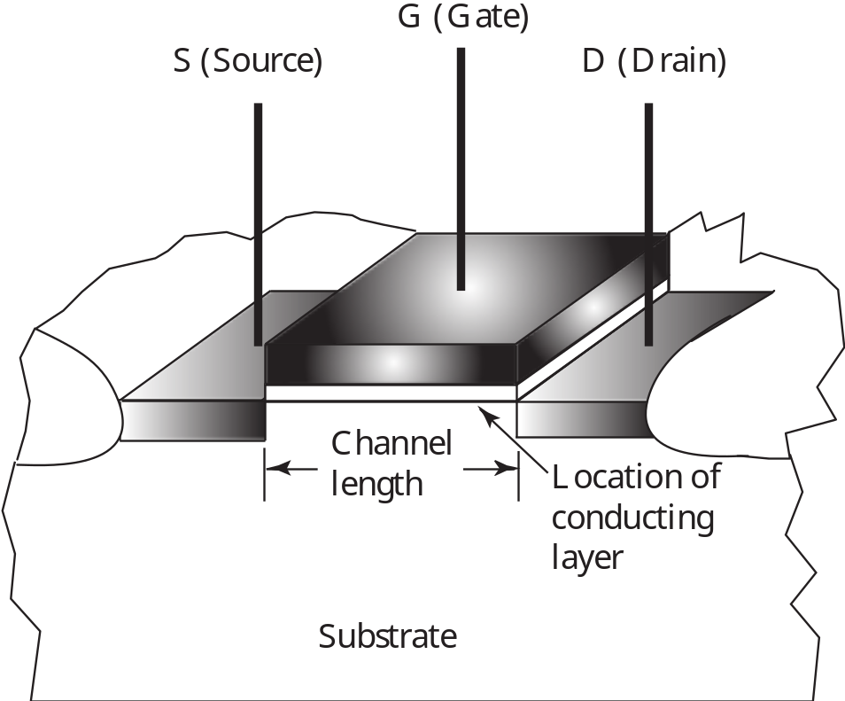
MOS Transistor
7 - <number>

Slide 5
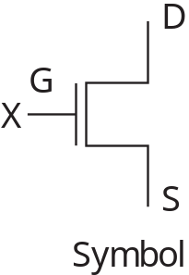
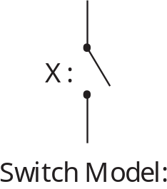
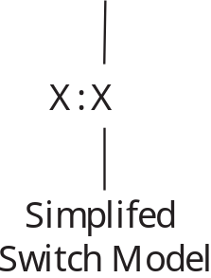
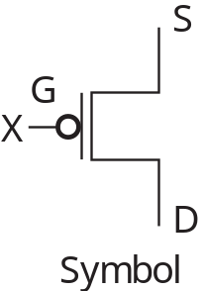
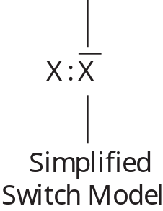
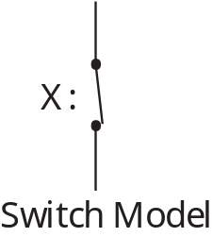
Switch Models for MOS Transistors
n-Channel – Normally Open (NO) Switch Contact
p-Channel – Normally Closed (NC) Switch Contact
7 - <number>

Slide 6
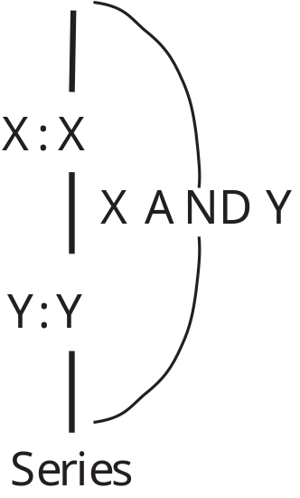
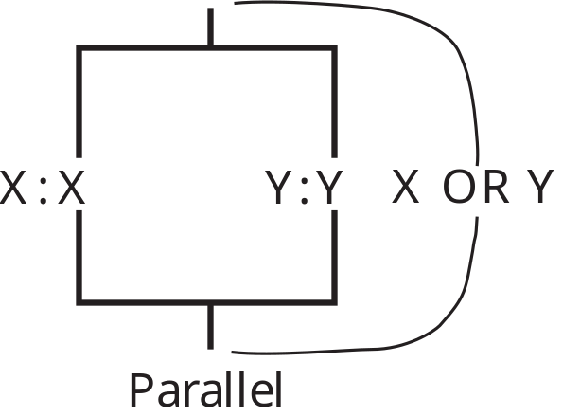
Circuits of Switch Models
Series
Parallel
7 - <number>

Slide 7
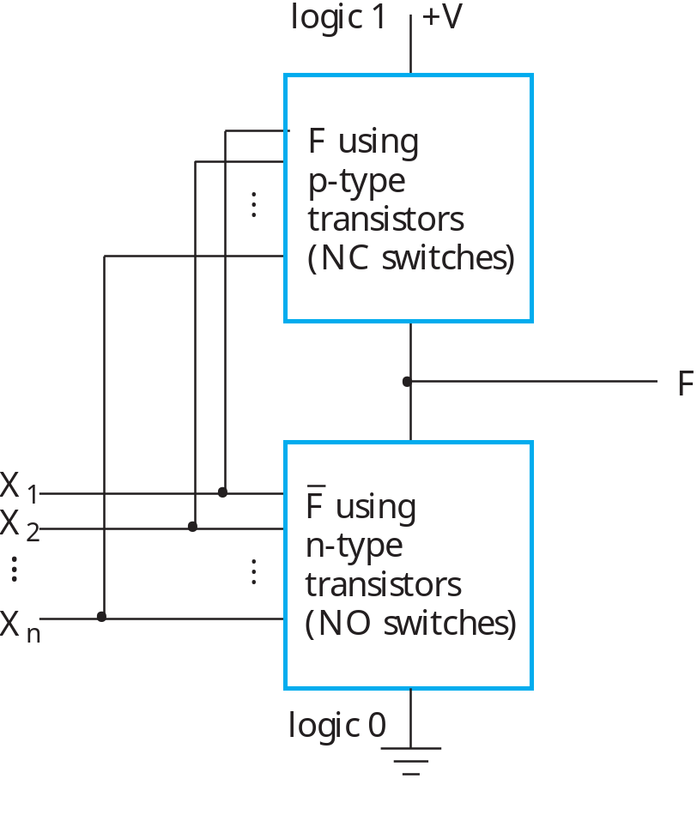
Fully-Complementary CMOS Circuit
Circuit structure for fully-complementary CMOS gate
7 - <number>

Slide 8

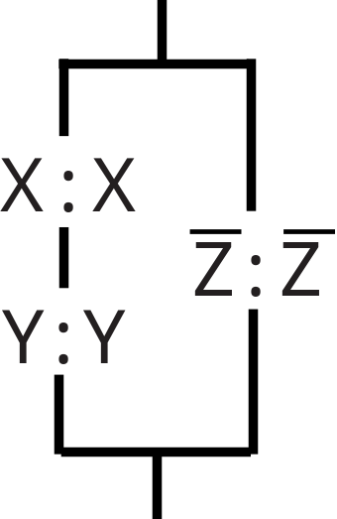
CMOS Circuit Design Example
Find a CMOS gate with the following function:
Beginning with F0, and using F’
The switch model circuit in terms of NO switches:
7 - <number>

Slide 9
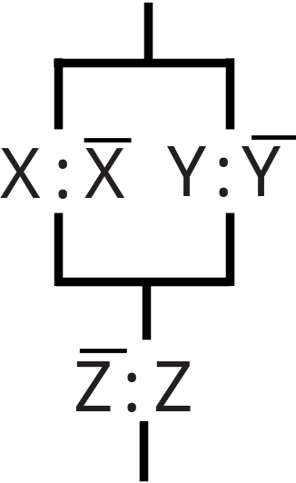
CMOS circuit design example
The switch model circuit for F1 in terms of NC contacts is the dual of the switch model circuit for F0:
The function for this circuit is:
which is the correct F.
7 - <number>

Slide 10
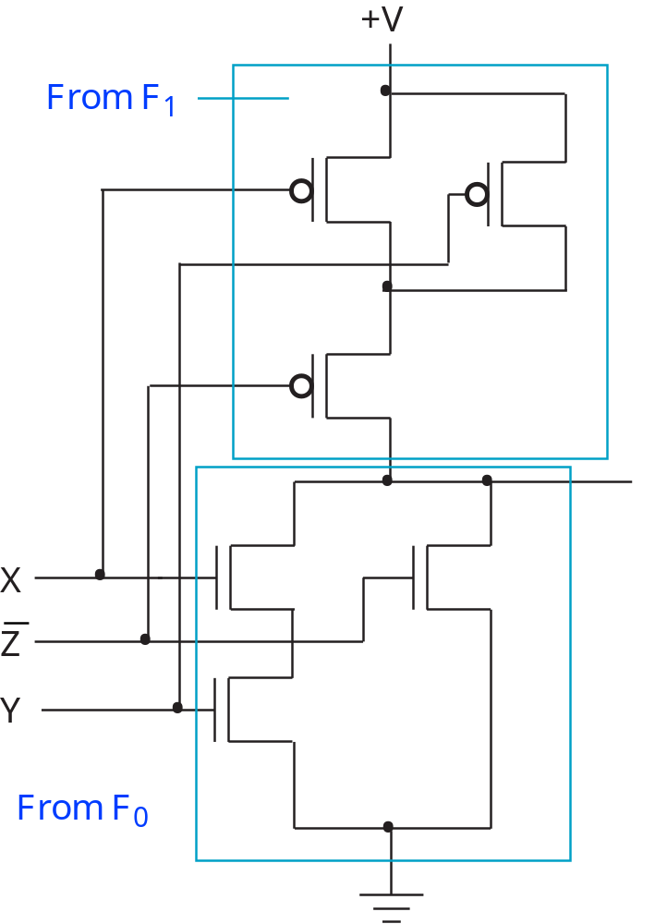
CMOS circuit design example
Replacing the
switch models
with CMOS
transistors;
note input
Z’ must be
used.
7 - <number>

Slide 11
ASIC (Application Specific Integrated Circuit) and CAD
  integrated circuit (IC) components performing a specialized task or a limited set of tasks
  large market sharing
  issues
    volume of sales
    fast design time
    low design cost
    design quality measured by performance and manufacturing yield
  Computer-Aided Design (CAD) techniques
    reduction of design time
    optimization of design quality : optimization of large-scale circuits (millions of transistors) is a complex problem
7 - <number>

Slide 12
Circuit Classifications
  semiconductor materials :
    Silicon on sapphire, or p-well and n-well
    Gallium-arsenide
  electronic device types :
    Complementary Metal Oxide Semiconductor (CMOS) : PMOS and NMOS
    Bipolar
    Combination of CMOS and Bipolar : BiCMOS
  analog and digital
    Analog circuit : information is related to the value of a continuous electrical parameter such as voltage or current (power amplifier for an audio system)
    Digital circuit : information is related to the range of voltages at circuit internal nodes having binary values (logic 0 and 1)
7 - <number>

Slide 13
Circuit classification
  Digital circuits in mode of operation : synchronous and asynchronous circuits
    Synchronous circuit : a global clock controls the timing of the circuit, dominating digital circuit design, needs clock distribution
    Asynchronous circuit : No global clock signal
M
Combinational
M
φ
φ
Combinational
input
output
7 - <number>

Slide 14
Circuit classification
Microelectronic Design Styles
  custom design: functional and physical design are hand-crafted, requiring an extensive effort of a design team to optimize each detailed feature of the circuit
    expensive
    large design time
    high density, performance design
  semi-custom design:
  cell-based array-based
  Standard cells Macro Cells Prediffused Prewired
  Hierarchical cells Generators: Gate arrays Anti-fuse based
  Memory, PLA, Sea of gates Memory based
  Sparse logic
7 - <number>

Slide 15
Cell based design
  Standard-cell design
    fundamental cells are designed by cell generators and stored in the library
    updates are necessary as semiconductor technology progresses
    library binding or technology mapping from the library
  Hierarchical standard-cell design: larger cells are derived by combining smaller cell
7 - <number>

Slide 16
Macro-cell based design
  Macro-cell based design
    automatic synthesis of memory arrays
      RAM : read/write memory (random access)
      ROM : read-only memory
    programmable logic arrays (PLA) : a regular layout structure for implementing sum of products.
  ex) f1 = a’ + bc, f2 = a’b
Product terms
F1(x1, x2, …,xn)
F2(x1, x2, …,xn)
…………………
Fm(x1, x2, …, xn)
input
lines
AND
array
OR
array
a
b
c
f1
f2
7 - <number>

Slide 17
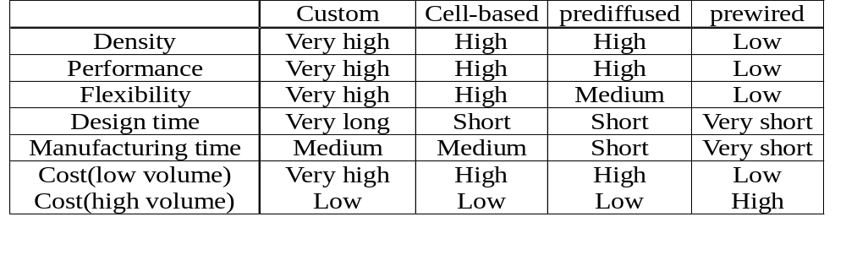
Array based design
  Prediffused (mask programmable) based design
    Gate arrays
  Prewired (field programmable gate arrays) based design
    Anto-fuse based
    memory based
Comparison of design styles
7 - <number>

Slide 18

Circuit design
  design
    modeling: representing ideas, modeling by Hardware Description Languages
    synthesis and optimization: detailed model of the circuit and performance enhancement for speed, area, and power
    validation: simulation and verification
  fabrication:
    start with lightly doped silicon wafers 150~300 mm diameter & 1 mm thick
    4 categories of processes:
    1. Pattern transfer (lithograph)
    2. Selective removal of material (etching)
    3. Addition of material layers
    4. Addition & activation of impurities
die is one chip (≅ 10 mm)
7 - <number>

Slide 19
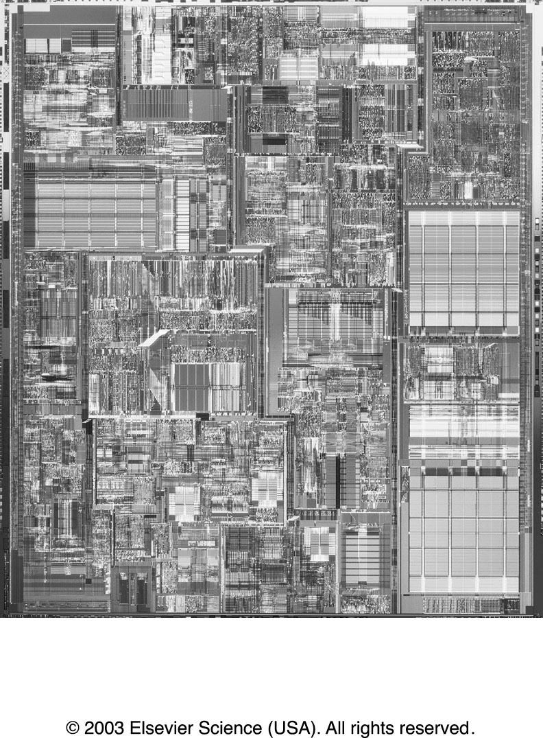
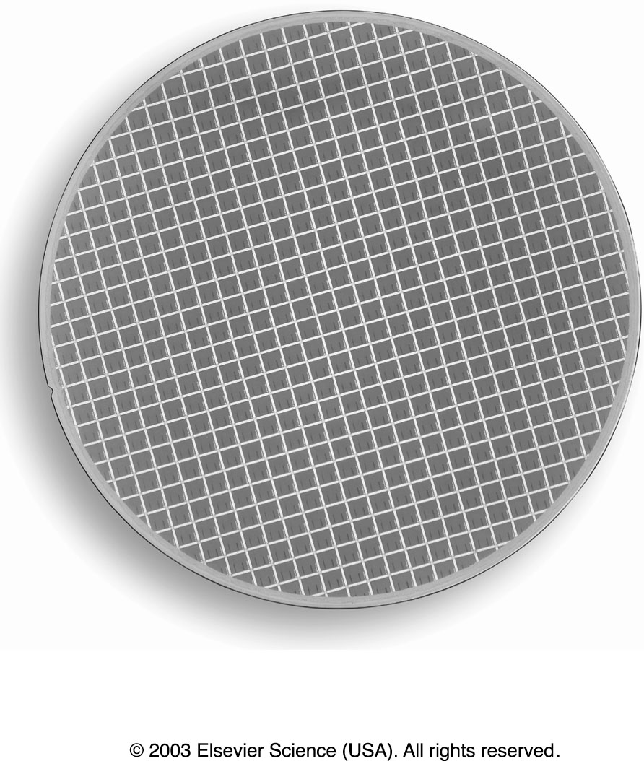
Pentium 4 microprocessor die and 8-inch wafer
7 - <number>

Slide 20
fabrication
    Pattern transfer (lithograph)
    1. Optical lithography (high throughput)
    UV light (X-ray) 0.8 resolution limit
    mask contains full wafer image (i.e. multiple chip image)
    2. Direct write electron beam lith (direct step on wafer)
    mask contains only 1 copy of chip (5x or 10x), low throughput, high resolution
    Before the exposure of each layer, wafer is coated with light-sensitive material called photoresist
mask
Pattern
transfer
system
CAD DB
Mask maker
Patterned
wafer
Pattern
generation tape
Final full layout
CAD DB
E-Beam System
Patterned wafer
7 - <number>

Slide 21
fabrication
    Selective removal (Etching)
    1. Wet etching : chemical acid
    2. Dry etching : plasma, RIE (reactive iron etch), ion milling, …
    Mast portions of layer that we want to keep such that etch will not attack parts.
    Addition of layers : SiO2 (Oxide), Si3N4 (Nitride), polysilicon, aluminum
    Addition of impurities : diffusion area n-type and p-type
    Wafer is placed into impurity rich environment and heated.
    Mask off regions to selective dope wafer.
  Testing
  Packaging
    Slicing
    Packaging
7 - <number>

Slide 22
Example of etching
Silicon wafer
photoresist
SiO2 (1μm)
Silicon wafer
UV light
glass mask
mask pattern
photoresist
SiO2 (1μm)
Silicon wafer
Silicon wafer
7 - <number>

Slide 23
Design Flow Example
Functional Specification
VHDL Coding
Behavioral Simulation
Architectural/Logic Synthesis
Gate-level Simulation
Back annotation
In-place optimization
Placement & Routing
Macro-cell, Standard Cell, Gate Array, FPGA, IP
7 - <number>

Slide 24
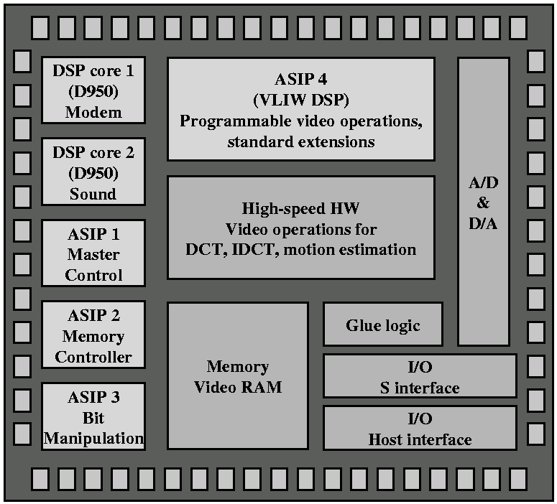
System-On-Chip
7 - <number>

Slide 25
Circuit Design Constraints
Performance
  Timing models (RC delay, table model, non-linear equations)
Area
  Size shrinks due to technology improvement
Power
  3 types of power consumption
    Dynamic
    Short circuit
    Leakage
Testability
Design time
Cost
Yield
7 - <number>

Slide 26
Performance constraint
Timing analysis
  Entire chip
  Critical path
  Block
  Latch (setup and hold time)
3 levels of analysis
  Transistor(Switch)-Level , Logic(Gate)-Level, High-Level
High Level Analysis
  directly operate on the internal representation of the behavioral specifications, so it is quite obvious that the chosen formulation style has a lasting effect to later design steps and to the final result.
7 - <number>

Slide 27
Performance analysis – Gate level
Finding circuit delay from input pin to output pin
- Graph-based formulation
  Convert circuit into a graph
  One node per pin
  Weight is delay from pin in to pin out
a
R= 5, F = 3
b
R= 3, F = 1
R= 5, F = 3
a
5
3
5
3
3
b
1
7 - <number>

Slide 28
Performance analysis – Transistor level
  Treats a circuit as a collection of bidirectional switches,
  rather than as a collection of unidirectional Boolean gates.
  Switch level timing analyzer : LEADOUT, Pearl, Crystal, PathMill
  Circuit level timing analyzer : ETA (Electrical-Level Timing Analysis
    SPICE circuit simulation
V
pwr
Input Voltage
Waveform
input
output
V
th
Delay
Output Voltage
Waveform
Time
7 - <number>

Slide 29
Timing Macro-modeling techniques
Table lookup (or Tabular) delay methods
  It has a drawback which is the long time required for precharacterization of primitive subcircuits with a variety of input slopes and output loads.
RC delay and AWE methods
  Elmore delay model, pi model, and so on.
Inverter analysis techniques
Nonlinear macro-modeling technique
7 - <number>

Slide 30
Performance Optimization
Cost-Delay Curve
cost
T_max
T_spec
T_min
delay
7 - <number>

Slide 31
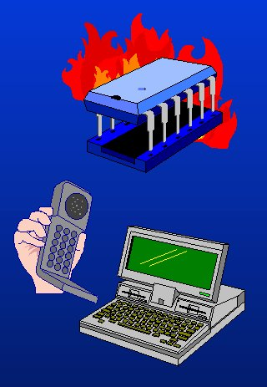
Power
Hot chips
DEC Alhpa 72W, Pentimum Pro 40W
Next Generation uP chip - 100W
 Performance degradation
 Reduction in chip lifetime
 Cost of specialized sinks/packaging
Portable Electronics
 Low battery life
 Reliability and performance issues
 Expensive packaging required
7 - <number>

Slide 32
Power
Power as a design constraint in mobile embedded system
Performance
Area
Power
7 - <number>

Slide 33
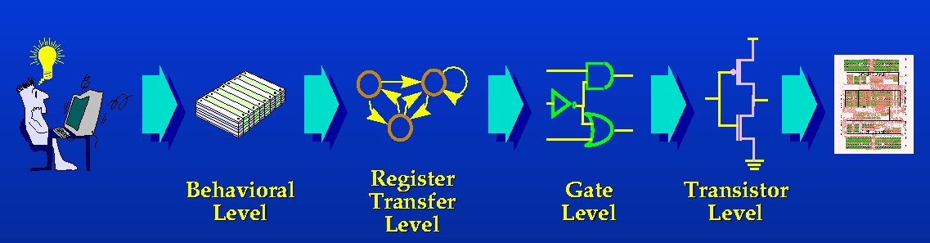
Computer aided design for power
Power oriented design philosophy.
 Estimation
 Optimizaiton
Techniques for estimation and optimization at every stage of design flow.
7 - <number>

Slide 34
Source of power consumption
Dynamic Power Consumption
  Charging and Discharging Capacitors
Short Circuit Currents
  short circuit path between supply rails during switching
Leakage
  Leaking diodes and transistors
I_{load}
I_{leakage}
I_{sc}
F : frequency of clocking
N: number of times gate switches in a clock cycle
7 - <number>

Slide 35
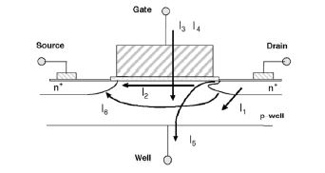
Leakage current
Current flowing from metal to ground
We describe six short-channel leakage mechanisms.
I1 is the reverse-bias pn junction leakage;
I2 is the subthreshold leakage;
I3 is the oxide tunneling current;
I4 is the gate current due to hot-carrier injection;
I5 is the GIDL;
I6 is the channel punchthrough current.
Currents I2, I5, and I6 are off-state leakage mechanisms, while
and occur in both ON and OFF states. I4 can occur in the off state, but more typically occurs during the transistor bias states in transition.
7 - <number>

Slide 36
Transistor level power estimation
Circuit level simulation
  By solving equations
  Most accurate
  Vector dependent
  Runtime cost too high
Switch-level estimation
  Event driven simulation (modeling transistor as on, off switch)
  RC delay model
  Dynamic and short circuit power estimation
  Faster but not accurate as circuit-level
7 - <number>

Slide 37
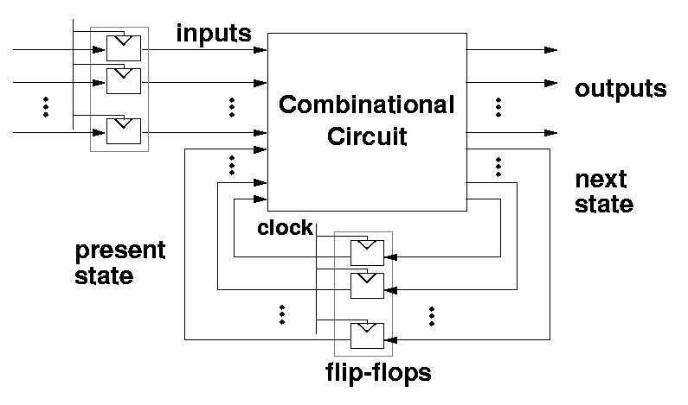
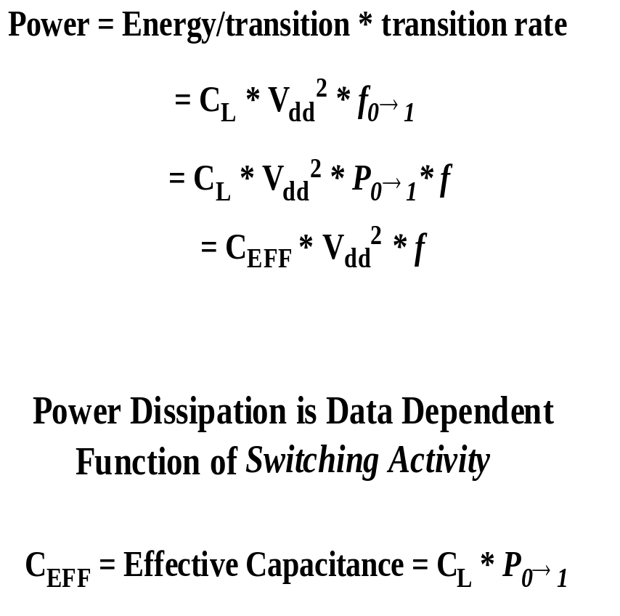
Gate-level power estimation
Dynamic power estimation
7 - <number>

Slide 38
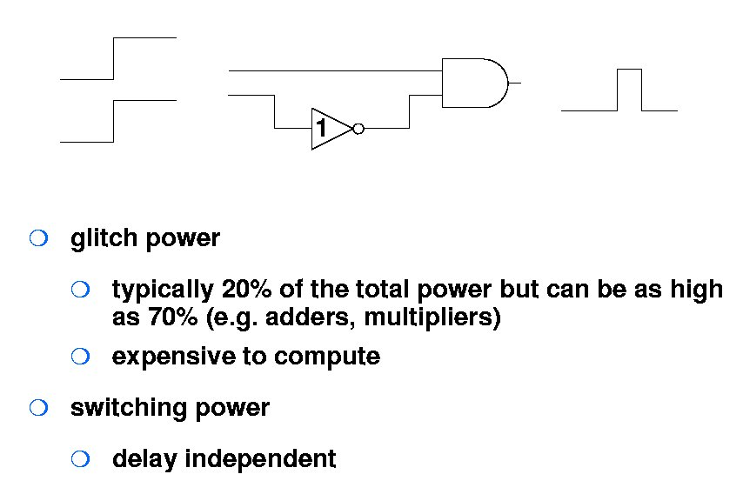
Gate-level power issues
Capacitance modeling
  RLC value extraction from design
  3D extraction
Glitch modeling
7 - <number>

Slide 39
Binary Decision Diagram (BDD)
Why BDD for functional verification?
  BDDs are Canonical (each Boolean function has its own unique BDD, modulo ordering of variables)
  So two functions are identical if and only if their BDDs are identical
  BDDs are compact in many cases, compared to SOP
    Parity trees, adders, control logic (linear vs exponential)
    However multipliers are bad, and a few others
7 - <number>

Slide 40
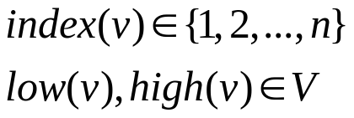

BDD representation
Definition
A function graph is a rooted, directed graph with vertex set V containing two types of vertices.
- Nonterminal vertex : index and two children
-Terminal vertex : value
Restriction
For any nonterminal vertex v, if low(v)is also nonterminal, then we must have index(v) < index(low(v)). Similarly, if high(v) is nonterminal, then we must have index(v) < index(high(v)).
=> Acyclic graph.
7 - <number>

Slide 41
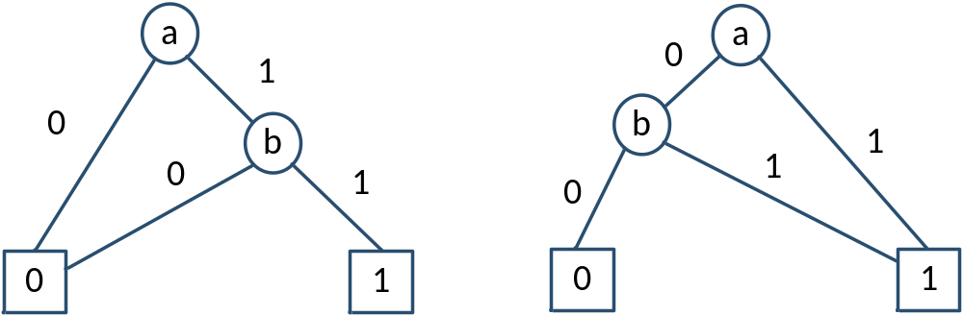
BDD Example
ab
a+b
7 - <number>

Slide 42
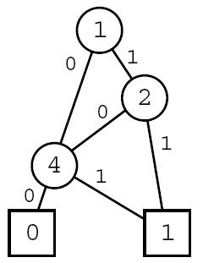
BDD example
X1•X2+X4
7 - <number>

Slide 43
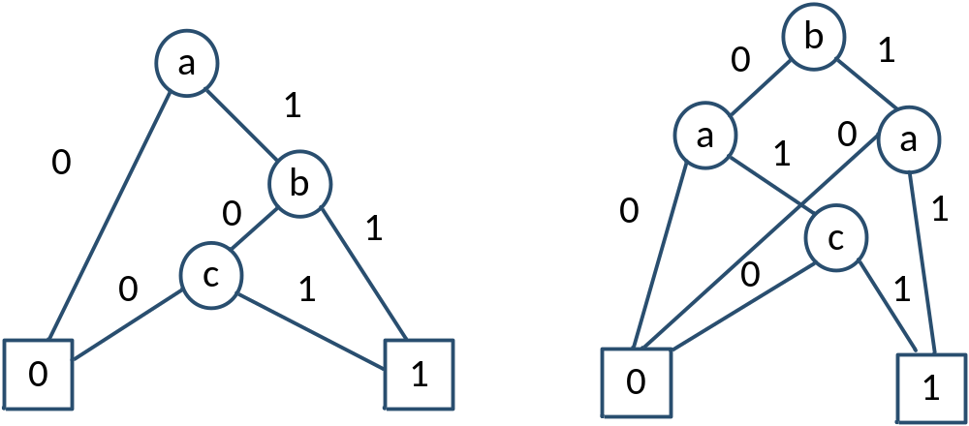
OBDD (Ordered Binary Decision Diagram)
The input variables are ordered
Every path from source to terminal visits the input variables in ascending order
a,b,c
b, a, c
F = ab+ac
7 - <number>

